Slide 1
Manipulating Information

Slide 2
Outline
Bit-level operations
Suggested reading
2.1.6~2.1.9

Slide 3
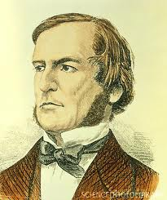

Boolean Algebra
Developed by George Boole(1815-1864)
Algebraic representation of logic
Encode “True” as 1
Encode “False” as 0
Claude Shannon(1916–2001)founded the information theory
made the connection between Boolean algebra and digital logic
Plays a central role in the design and analysis of digital systems

Slide 4
Boolean Algebra
And
A&B = 1 when both A=1 and B=1
Or
A|B = 1 when either A=1 or B=1
Not
~A = 1 when A=0
Exclusive-Or (Xor)
A^B = 1 when either A=1 or B=1, but not both

Slide 5
General Boolean Algebras
Operate on Bit Vectors
Operations applied bitwise
01101001
& 01010101
01000001
01101001
| 01010101
01111101
01101001
^ 01010101
00111100
~ 01010101
10101010

Slide 6
General Boolean Algebras
Representation of Sets
Width w bit vector represents subsets of {0, …, w–1}
a_{j} = 1 if j ∈ A
01101001 { 0, 3, 5, 6 }
01010101 { 0, 2, 4, 6 }
& Intersection 01000001 { 0, 6 }
| Union 01111101 { 0, 2, 3, 4, 5, 6 }
^ Symmetric difference 00111100 { 2, 3, 4, 5 }
~Complement 10101010 { 1, 3, 5, 7 }

Slide 7
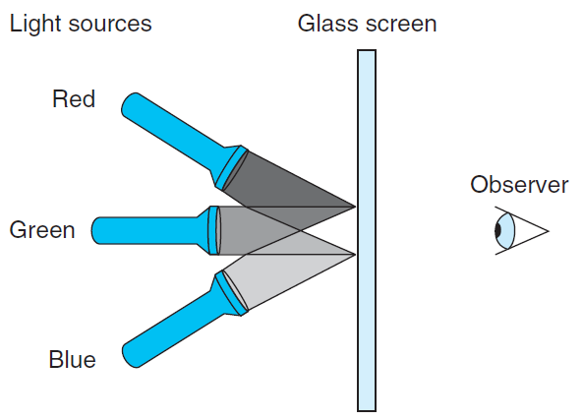
RGB Color Model

Slide 8
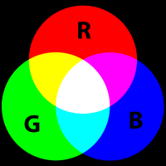
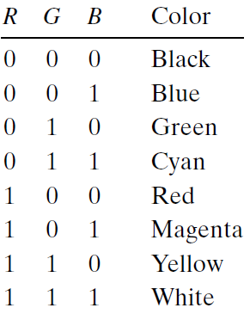
RGB Color Model
Magenta
Cyan

Slide 9
RGB Color Model
What would be the complement of each of the eight colors listed above?
The complement of a color is formed by
turning off the lights that are on and
turning on the lights that are off
Describe the effect of applying Boolean operations on the following colors:
Blue | Green =
Yellow & Cyan =
Red ^ Magenta =

Slide 10
Bit-Level Operations in C
Operations &, |, ~, ^ Available in C
Apply to any “integral” data type
long, int, short, char
View arguments as bit vectors
Arguments applied bit-wise

Slide 11
Bit-Level Operations in C
~0x41 | 0xBE
~0x00 | 0xFF
0x69 & 0x55 | 0X41
0x69 | 0x55 | 0x7D
~0100 0001
1011 1110
~0000 0000
1111 1111
0110 1001 & 0101 0101
0100 0001
0110 1001 | 0101 0101
0111 1101

Slide 12
Cool Stuff with Xor
Bitwise Xor is form of addition
With extra property that every value is its own additive inverse
A ^ A = 0
异或相当于不考虑进位的加法操作

Slide 13
Cool Stuff with Xor
int inplace_swap(int *x, int *y)
{
*x = *x ^ *y; /* #1 */
*y = *x ^ *y; /* #2 */
*x = *x ^ *y; /* #3 */
}

Slide 14
Cool Stuff with Xor
1 void reverse_array(int a[], int cnt) {
2 int first, last;
3 for (first = 0, last = cnt-1;
4 first <= last;
5 first++,last--)
6 inplace_swap(&a[first], &a[last]);
7 }
该程序有BUG：若长度l为奇数，则l/2处的数x将由于x^x=0而变为0，从而可能改变原来的数组

Slide 15
Mask Operations
Bit pattern
0xFF(1111 1111)
Having 1s for the least significant eight bits
Indicates the lower-order byte of a word
Mask Operation
X = 0x89ABCDEF
X & 0xFF =0x000000EF
Bit Pattern ~0
Why not 0xFFFFFFFF?

Slide 16
Mask Operations
Write C expressions that work for any word size w ≥ 8
For x = 0x87654321, with w = 32
The least significant byte of x, with all other bits set to 0(只保留最后一个字节的数字)
[0x00000021]
x & 0xFF

Slide 17
Mask Operations
All but the least significant byte of complemented, with the least significant byte left unchanged(最后一个byte的数不变，其余的取反)
[0x789ABC21]
The least significant byte set to all 1s, and all other bytes of x left unchanged.(最后一个byte每一位都变为1，其余位置上数字不变)
[0x876543FF].
x ^ ~0xFF
x | 0xFF

Slide 18
Bis & Bic
Set result z to x and modify it
z = bis (int x, int m) (bit set)
Set result z to 1 at each bit position where m is 1
z = bic(int x, int m) (bit clear)
set result z to 0 at each bit position where m is 1
The Digital Equipment VAX
Use bis anf bic to implement
Or(int x, int y)
Xor(int x, int y)
bis(x, y)
bis(bic(x, y), bic(y,x))

Slide 19
Logical Operations in C
Logical Operators
&&, ||, !
View 0 as “False”
Anything nonzero as “True”
Always return 0 or 1
Early termination (short cut)(逻辑运算的短路效应)

Slide 20
Logical Operations in C
Examples (char data type)
!0x41 --> 0x00
!0x00 --> 0x01
!!0x41 --> 0x01
0x69 && 0x55 --> 0x01
0x69 || 0x55 --> 0x01

Slide 21
Short Cut in Logical Operations
a && 5/a(若a=0会由于短路效应而返回0)
If a is zero, the evaluation of 5/a is stopped
avoid division by zero
p && *p(若p=nullptr会由于短路效应而返回0)
Never cause the dereferencing of a null pointer
Using only bit-level and logical operations
Implement x == y
it returns 1 when x and y are equal, and 0 otherwise
!(x^y)(用于判断x和y是否相等的位运算)
但是上述情况最好不要出现

Slide 22
Shift Operations in C(移位运算符)
Left Shift: x << y（C默认逻辑左移，即填0顶位）
Shift bit-vector x left y positions
Throw away extra bits on left
Fill with 0’s on right
Argument x
01100010
<< 3
00010000
Argument x
10100010
<< 3
00010000

Slide 23
Shift Operations in C
Right Shift: x >> y
Shift bit-vector x right y positions
Throw away extra bits on right
Logical shift(逻辑右移)
Fill with 0’s on left
Arithmetic shift(算术右移)
Replicate most significant bit on right
Useful with two’s complement integer representation (especially for the negative number )(最高位为1则全部填充1，否则全部填充0)→整数的补码
Argument x
01100010
Log. >> 2
00011000
Arith. >> 2
00011000
Argument x
10100010
Log. >> 2
00101000
Arith. >> 2
11101000
C默认算数右移

Slide 24
Shift Operations in C
What happens ?
int lval = 0xFEDCBA98 << 32;
int aval = 0xFEDCBA98 >> 36;
unsigned uval = 0xFEDCBA98u >> 40;
It may be (gcc中移位位数>=32时会模32取余)
lval 0xFEDCBA98 (0)
aval 0xFFEDCBA9 (4)
uval 0x00FEDCBA (8)
Be careful about(注意运算优先级)
1<<2 + 3<<4 means 1<<(2 + 3)<<4

Slide 25
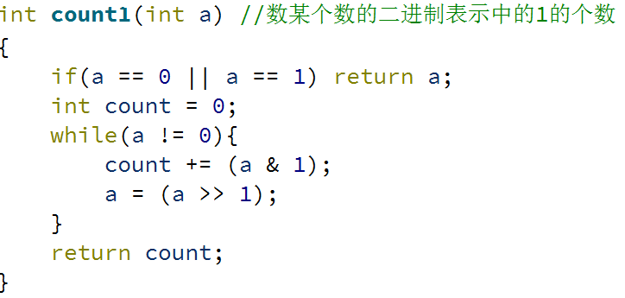
bitCount
Returns number of 1's a in word
Examples: bitCount(5) = 2, bitCount(7) = 3
Legal ops: ! ~ & ^ | + << >>
Max ops: 40
*若无此限制：

Slide 26
Sum 8 groups of 4 bits each(32位数分为8组)
int bitCount(int x) {(int为4byte)
int m1 = 0x11 | (0x11 << 8);(0001 0001 0001 0001)
int mask = m1 | (m1 << 16);(0001 0001 0001 0001 0001 0001 0001 0001)
int s = x & mask;(看0 4 8 12 16 20 24 28位置上有无1)
s += x>>1 & mask;(...1 5 9 13 17 21 25 29...)
s += x>>2 & mask;(...2 6 10 14 18 22 26 30...)
s += x>>3 & mask;(...3 7 11 15 19 23 27 31...)(*)
运行至(*)式时32位的s若分为8组，则每组最多为0100（十进制的4）

Slide 27
Combine the sums
/* Now combine high and low order sums */
s = s + (s >> 16);(将上述8组从中间分为两个4组并令左右两半相加,最大为1000)
/* Low order 16 bits now consists of 4 sums.
Split into two groups and sum */
mask = 0xF | (0xF << 8);(0000 1111 0000 1111)(后16位)
s = (s & mask) + ((s >> 4) & mask);(后4组中2 4组与1 3组分别相加)
return (s + (s>>8)) & 0x3F;(后4组中的2 4组再相加得到结果)}

Slide 28
Information Storage

Slide 29
Outline
Pointers and word size
Byte ordering
Suggested reading
The first paragraph of 2.1
2.1.2, 2.1.3, 2.1.4, 2.1.5
1.7.3

Slide 30
Outline
Pointers and word size
Byte ordering

Slide 31
Computer Hardware - Von Neumann Architecture
Instructions / Program
Main
Memory
Arithmetic
Unit
Control
Unit
PC
AC
IR
SR
Addresses
Input/Output
Unit
E.g. Storage

Slide 32
Storage
The system component that remembers data values for use in computation
A wide-ranging technology
RAM chip
Flash memory
Magnetic disk
CD
Abstract model
READ and WRITE operations

Slide 33
READ/WRITE operations
Two important concepts
Name and value
WRITE(name, value) value ← READ(name)
WRITE operation specifies
a value to be remembered
a name by which one can recall that value in the future
READ operation specifies
the name of some previous remembered value
the memory device returns that value

Slide 34
Memory
Bytes
Addr.
One kind of storage device
Value has only fixed size (usually byte)
Name belongs to a set consisting of consecutive integers started from 0
The integer number is called address(地址)
The set is called address space
0000
0001
0002
0003
0004
0005
0006
0007
0008
0009
0010
0011
0012
0013
0014

Slide 35
Word Size
A virtual address(虚拟地址) is encoded by
a word with fixed size
Word size indicates the size of such kind of the word
Which defines the maximum size of the virtual address space
the most important system parameter determined by the word size

Slide 36
Word Size
For machine with n-bit word size
Virtual address can range from 0 to 2^{n}-1
Most current machines are 64 bits (8 bytes)
Potentially address ≈ 1.8 X 10¹⁹ bytes
Most current machines also support 32 bits (4 bytes)
Limits addresses to 4GB
Becoming too small for memory-intensive applications

Slide 37
Data Size
Machines support multiple data formats
Always integral number of bytes

Slide 38
Data Size
C Declaration |  | Bytes
Signed | Unsigned | 32-bit | 64-bit
char | unsigned char | 1 | 1
short | unsigned short | 2 | 2
int | unsigned | 4 | 4
long | unsigned long | 4 | 8
int32_t | uint_32 | 4 | 4
int64_t | uint_64 | 8 | 8
char * |  | 4 | 8
float |  | 4 | 4
double |  | 8 | 8

Slide 39
intN_t and uintN_t
Another class of integer types
specifying N-bit signed and unsigned integers
Introduced by the ISO C99 standard
In the file stdint.h.
Typical values
int8_t, int16_t, int32_t, int64_t
unit8_t, uint16_t, uint32_t, uint64_t
N are implementation dependent

Slide 40
Data Size Related Bugs
Difficulty to make programs portable across different machines and compilers
The program is sensitive to the exact sizes of the different data types
The C standard sets lower bounds on the numeric ranges of the different data types
but there are no upper bounds

Slide 41
Data Size Related Bugs
32-bit machines have been the standard from 1990s to 2010s
Many programs have been written
assuming the allocations listed as “32-bit” in the table
With the increasing of 64-bit machines
many hidden word size dependencies show up as
bugs in migrating these programs to new machines

Slide 42
Example
At the time 32-bit dominated, many programmers assumed that
a program object declared as type int can be used to store a pointer
This works fine for most 32-bit machines
But leads to problems on an 64-bit machine

Slide 43
Address issues
IBM S/360: 24-bit address
PDP-11: 16-bit address
Intel 8086: 16-bit address
X86 (80386): 32-bit address
X86 32/64: 32/64-bit address

Slide 44
64-bit data models
Processors
4-bit | 8-bit | 12-bit | 16-bit | 18-bit | 24-bit | 31-bit | 32-bit | 36-bit | 48-bit | 64-bit | 128-bit
Applications
 |  |  | 16-bit |  |  |  | 32-bit |  |  | 64-bit
Data Sizes
nibble octet byte word dword qword

Slide 45
64-bit data models
Data model | short | int | long | long long | pointers | Sample operating systems
LLP64 | 16 | 32 | 32 | 64 | 64 | Microsoft Win64 (X64/IA64)
LP64 | 16 | 32 | 64 | 64 | 64 | Most Unix and Unix-like systems (Solaris, Linux, etc.)
ILP64 | 16 | 64 | 64 | 64 | 64 | HAL(Fujitsu subsidiary)
SILP64 | 64 | 64 | 64 | 64 | 64 | ?

Slide 46
Outline
Pointers and word size
Byte ordering

Slide 47
Virtual Memory
The memory introduced in previous slides
is only an conceptual object and
does not exist actually
It provides the program with what appears to be a monolithic byte array
It is a conceptual image presented to the machine-level(机器层面) program

Slide 48
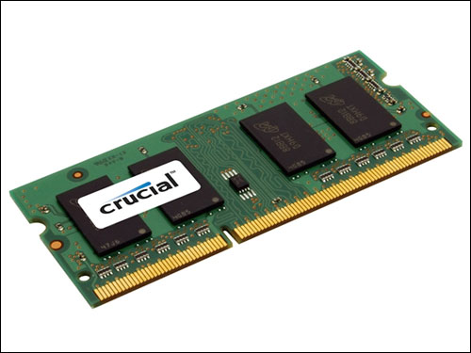
Virtual Memory
The actual implementation uses a combination of
Hardware
Software
Hardware
random-access memory (RAM) (physical)
disk storage (physical)
special hardware (performing the abstraction )
Software
and operating system software (abstraction)

Slide 49
Way to the Abstraction
Taking something physical and abstract it logical
Virtual memory
WRITE
(vadd value)
Operating
System
Special
hardware
RAM
Chips
Disk
storage
WRITE
(padd value)
READ(vadd)
READ(padd)
Abstraction
layer
Physical
layer

Slide 50
Subdivide Virtual Memory into More Manageable Units
One task of
a compiler and
the run-time system
To store the different program objects
Program data
Instructions
Control information

Slide 51
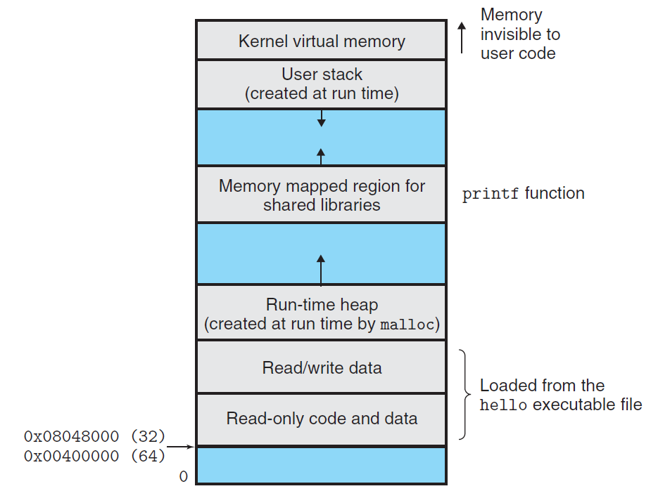
malloc:分配内存

Slide 52
Byte Ordering(字节地址排序)
How should a large object be stored in memory?
For program objects that span multiple bytes
What will be the address of the object?
How will we order the bytes in memory?
A multi-byte object is stored as
a contiguous sequence of bytes
with the address of the object given by the smallest address of the bytes used

Slide 53
Byte Ordering
Little Endian(字节序)
Least significant byte has lowest address
Intel
Big Endian
Least significant byte has highest address
Sun, IBM
Bi-Endian
Machines can be configured to operate as either little- or big-endian
Many recent microprocessors

Slide 54
Big Endian(字节序) (0x1234567)
0x100
0x101
0x102
0x103
01
23
45
67

Slide 55
Little Endian (0x1234567)
0x100
0x101
0x102
0x103
67
45
23
01

Slide 56
How to Access an Object
The actual machine-level program generated by C compiler
simply treats each program object as a block of bytes
The value of a pointer in C
is the virtual address of the first byte of the above block of storage(C中pointer指向地址是对应虚拟地址的首字节对应的数)

Slide 57
How to Access an Object
The C compiler
Associates type information with each pointer
(在编译环节C中pointer会带有指向的数据类型信息)
Generates different machine-level code to access the pointed value
stored at the location designated by the pointer depending on the type of that value
The actual machine-level program generated by C compiler
has no information about data types (机器语言不带有)

Slide 58
Code to Print Byte Representation
typedef unsigned char *byte_pointer;
(typedef的作用是声明一个新的类型)
void show_bytes(byte_pointer start, int len)
{
int i;
for (i = 0; i < len; i++)
printf("0x%p(用于打印地址)\t0x%.2x(打印2位16进制数)\n",
start+i, start[i](C中认为两者等效));
printf("\n");
}

Slide 59
Code to Print Byte Representation
void show_int(int x) {
show_bytes((byte_pointer) &x, sizeof(int));
}
void show_float(float x) {
show_bytes((byte_pointer) &x, sizeof(float));
}
void show_pointer(void *x) {
show_bytes((byte_pointer) &x, sizeof(void *));
}
(显式强制类型转化)
不同机器数据类型占用空间可能不同，sizeof防止崩溃

Slide 60
Features in C
typedef
Giving a name of type
Syntax(语法) is exactly like that of declaring a variable
printf
Format string: %d, %c, %x, %f, %p
sizeof
sizeof(T) returns the number of bytes required to store an object of type T
One step toward writing code that is portable across different machine types

Slide 61
Features in C
Pointers and arrays
start is declared as a pointer
It is referenced as an array start[i]
Pointer creation and dereferencing
Address of operator &
&x
Type casting
(byte_pointer) &x

Slide 62
Code to Print Byte Representation
void test_show_bytes(int val) {
int ival = val;
float fval = (float) ival;
int *pval = &ival;
show_int(ival);
show_float(fval);
show_pointer(pval);
}

Slide 63
Example
Linux 32: Intel IA32 processor running Linux
Windows: Intel IA32 processor running Windows
Sun: Sun Microsystems SPARC processor running Solaris
Linux 64: Intel x86-64 processor running Linux
With argument 12345 which is 0x3039

Slide 64
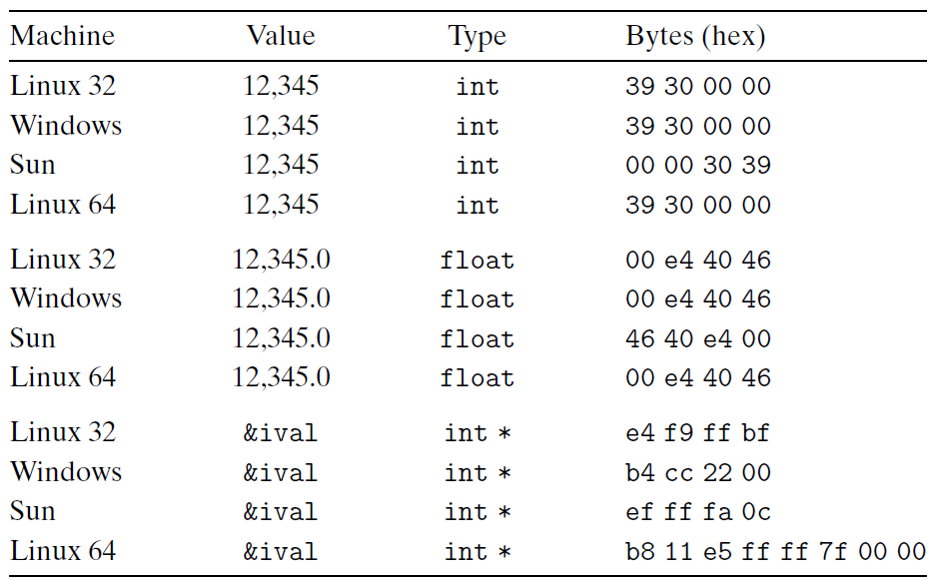
Example
Linux 32: Intel IA32 processor running Linux
Windows: Intel IA32 processor running Windows
Sun: Sun Microsystems SPARC processor running Solaris
Linux 64: Intel x86-64 processor running Linux
此图说明不同系统对不同类型数据的存储方式不同。

Slide 65
Representing Codes
int sum(int x, int y) {
return x + y;(在计算机内部以二进制方式运算)
}
Linux 32: 55 89 e5 8b 45 0c 03 45 08 c9 c3
Windows: 55 89 e5 8b 45 0c 03 45 08 5d c3
Sun: 81 c3 e0 08 90 02 00 09
Linux 64: 55 48 89 e5 89 7d fc 89 75 f8 03 45 fc c9 c3

Slide 66
Byte Ordering Becomes Visible
Circumvent the normal type system
Casting
Reference an object according to a different data type from which it was created
Strongly discouraged for most application programming
Quite useful and even necessary for system-level programming
Disassembler
80483bd: 01 05 64 94 04 08->add %eax, 0x8049464
Communicate between different machines

Slide 67
Representing Strings
Strings in C
Represented by array of characters
Each character encoded in ASCII format
String should be null-terminated Final character = 0(\0 的ASCII码 = 0)
\a \b \f \n \r \t \v
\\ \? \’ \” \000 \xhh
char S[6] = "12345";
Linux S
Sun S
31
31
32
32
33
33
34
34
35
35
00
00
一个char占用一个byte，所以不存在byte ordering的问题，故string基本上在不同系统中存储相同。

Slide 68
Representing Strings
Compatibility
Byte ordering not an issue
Data are single byte quantities
Text files generally platform independent
Except for different conventions of line termination character!
char S[6] = "12345";
Linux S
Sun S
31
31
32
32
33
33
34
34
35
35
00
00

Slide 69
Representing Strings
/* strlen: return length of string s */
int strlen(char *s)
{
char *p = s ;(初始地址)
while (*p != ‘\0’)
p++ ; (找到字符串结束的地址)
return p-s ;(由于地址连续，所以p-s就是长度)
}
<string.h>

Slide 70
Representing Strings
/* trim: remove trailing blanks, tabs, newlines */
int trim(char s[])
{
int n;
for (n = strlen(s)-1; n >= 0; n--)
if ( s[n] != ‘ ‘ && s[n] != ‘\t’ && s[n] != ‘\n’)
break;
s[n+1] = ‘\0’;
return n
}

